Slide 1


The Ins and Outs of Error Handling
C. David Littlejohn

Slide 2





Sponsored by:

Slide 3
About me
C. David Littlejohn
https://github.com/ergo3114
@littlejohnpsh
@pshchatt
PowerShell, Automation, IT Operations, Memes, Peer nominated crazy cat dad, Peer nominated Bronie

Slide 4
Reason I came up with this session
I don’t want to talk about it
#NeverForgetProdDatabaseTableNumberFourCirca2018 #InterventionWithManger

Slide 5
Why we do it?
A working script may not always work
Alert support there is an issue
Attempt to resolve
Notes:
(Example of CALWEB) Environments change all the time and may have adverse affects on your scripts
Someone needs to know
Can the program resolve the issue itself? Could be as easy as creating a new file when one does not exist to restarting a vApp within Vcenter.

Slide 6
Error Handling
Anticipation
Detection
Resolution
Notes:
Error handling refers to the anticipation, detection, and resolution of programming, application, and communications errors.
Anticipation – Be ready for when your environment is not the same as when you created your script
Detection – Know when that time comes
Resolution – Be able to overcome this obstacle
Show example 1

Slide 7
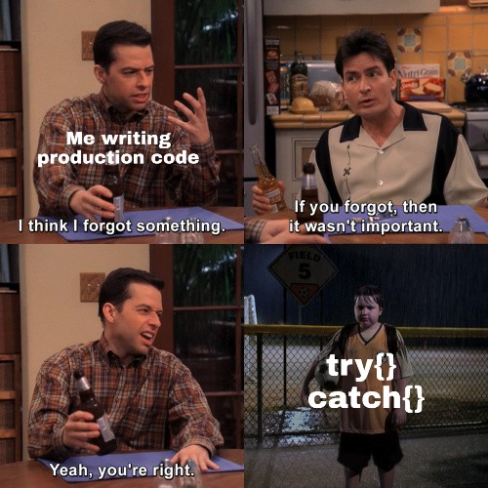
Obligatory Meme

Slide 8
Try/Catch
The simplest way to handle errors.
Think of this as a safety net
Keep the try block small
Notes:
EXAMPLE
Try = do this item until there is an error
Catch = perform a set of actions when there is an error
Large try blocks are not good. Assume you have a file that you are writing out to and you need as many lines to be written to paint a picture. If you have a large try block you may be loosing out on information because an unrelated process errors out.
Show example 2

Slide 9
Force a catch
The keyword is throw
Throw triggers a generic error
Add a message for the error
An alternative would be to use Write-Error
Notes:
Notice I did not call this a command since this is a keyword like break and exit. There are no real cmdlets in PowerShell for these.
The generic error is not a pretty one.
You can clean it up by using Write-Error. The default for Write-Error is a non-terminating error
Show example 3
Show example 4

Slide 10
Catch Specific Error
What do you I mean by this?
Why would we want to do this?
How do we do this?
Notes:
What - Catch a different error when a database connection fails versus when you divide by 0
Why – When a database connection errors out your need to perform different things such as closing the database connection. Vs. dividing by zero you need to perform division slightly different. Whether that means to just default the result to 0 or null.
Show example 5

Slide 11
Error Variable
$Error
Parameter
Notes:
$Error is an array of all errors in current session.
If you need to perform work on a specific error you can use the ErrorVariable parameter. This is only available when you use the cmdletbinding.
Show example 6 and 7

Slide 12
Gotcha
PowerShell error handling only works if the cmdlet throws an error
This prevents the correct use of ErrorVariable on cmdlets
You can use $PSItem (or $_)
Notes:
PowerShell’s fancy error handling only works if the function call succeeded.
The alternative would be to use $PSItem
$PSItem and $_ are exactly the same in regards to how they function and how fast they are. The real difference is that $_ is the v2 way and $PSItem is the v3+ way.
Show example 8 then 9

Slide 13
References
Understanding the Try/Catch Block in PowerShell by Adam Bertram https://mcpmag.com/articles/2016/08/18/try-catch-block-in-powershell.aspx
PowerShell: Everything you wanted to know about exceptions by Kevin Marquette https://kevinmarquette.github.io/2017-04-10-Powershell-exceptions-everything-you-ever-wanted-to-know/
About_Throw https://docs.microsoft.com/en-us/powershell/module/microsoft.powershell.core/about/about_throw?view=powershell-6
Error Handing by Margaret Rouse https://searchsoftwarequality.techtarget.com/definition/error-handling
An Introduction to Error Handling in PowerShell https://blogs.msdn.microsoft.com/kebab/2013/06/09/an-introduction-to-error-handling-in-powershell/
HOWTO: Find Specific Exceptions to Use with Try/Catch in PowerShell https://pleasework.robbievance.net/howto-find-specific-exceptions-to-use-with-trycatch-in-powershell/

Slide 14
Questions?
If you think of something after this session, catch me in the hall!

